Slide 1
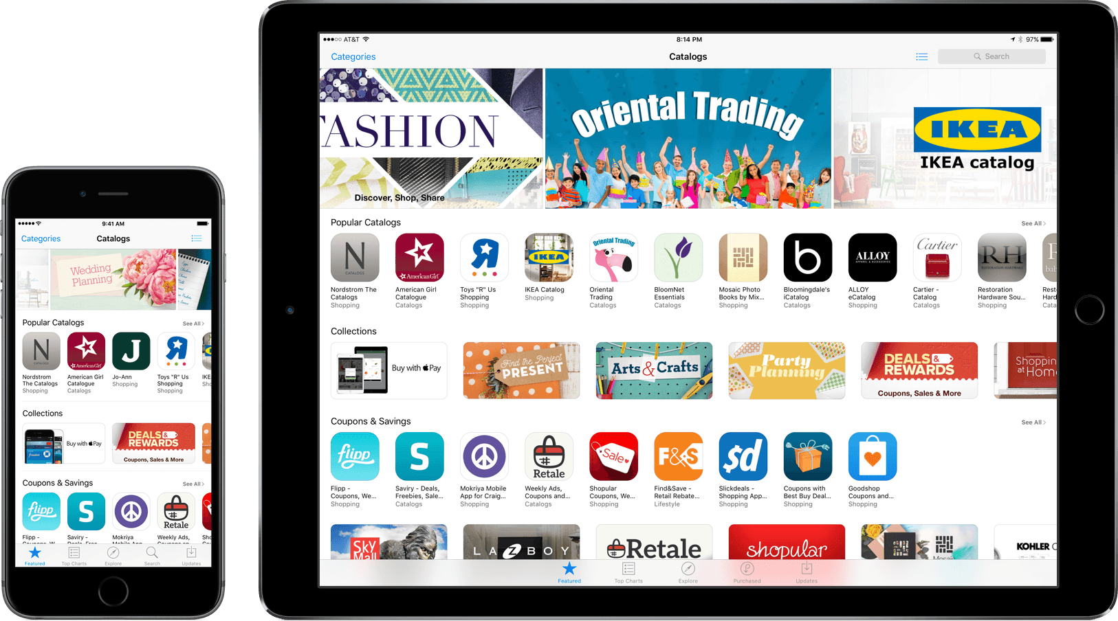
Apple Store Monetization Experiment Design
Find strategy on payment method to increase the revenue for entire store by 5% for Q3.

Slide 2
Outline
Exploratory Analysis
Experiment Design
Recommendation
Next Steps

Slide 3

Exploratory Analysis
15 Variables
566,699 Records
Notes:
user_id: Identifier for the user
country: IP country of the user
user_added_credit_card: If the user had ever added credit card before 5/1.
user_added_dcb**: If the user had ever added direct carrier billing before 5/1.
user_added_fop: If the user had ever added any payment method before 5/1.
user_added_gift_card: If the user had ever added gift card balance before 5/1.
user_added_paypal: If the user had ever added PayPal before 5/1.
initial_fop_set: If the user had form of payment as of 5/1.
spend_usd_next_14_days: the user has spent in the next 14 days, if any.
visit_before: If the user had visited the purchase flow, in the last 3 months.
saw_cart_before: If the user had put items in the shopping cart, in the last 3 months.
clicked_buy_before: If the user had clicked on the checkout button, in the last 3 months.
made_purchase_before: If the user made any purchase successfully, in the last 3 months.
existing_buyer: If the user had ever made purchase before 5/1.
buyer_week_before: Number of weeks when user made a purchase, in the last 8 weeks.

Slide 4
Data Processing
spend_usd_next_14_days
No 0 value. So NAs can be filled by 0.
user_added_credit_card, user_added_dcb, user_added_gift_card, user_added_paypal
They are NAs only when users don't have any fops.
Other features
The corresponding samples can be removed.
Duplicated Value Removal
Missing Value Imputation and Removal
484,357 Records
Notes:
What is Na Value

Slide 5
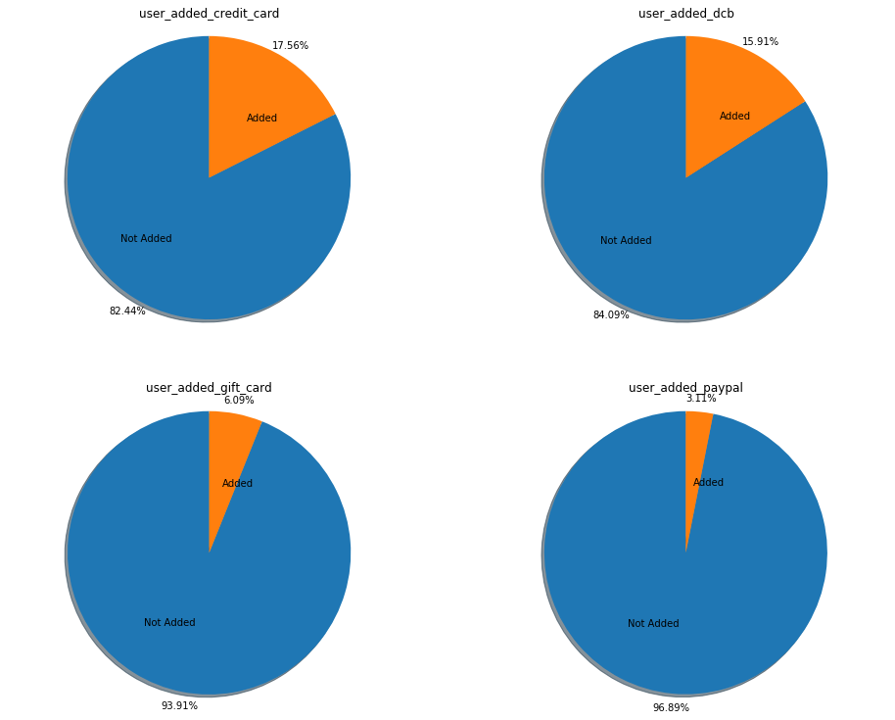
Data Visualization
-Form of Payment
Top 2 payment methods
Credit Card
Direct Carrier Billing
Notes:
DCB

Slide 6
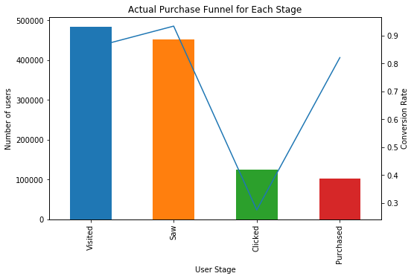
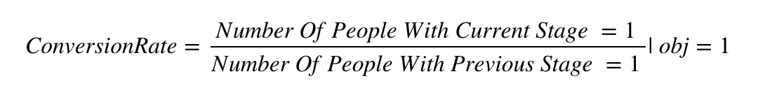
Data Visualization
-Conversion Rate
Good:
Overall conversion rate is high
Bad:
Saw_Cart -> Clicked(66%)
Notes:
Focus on payment method to further improve.
Conversion Rate

Slide 7
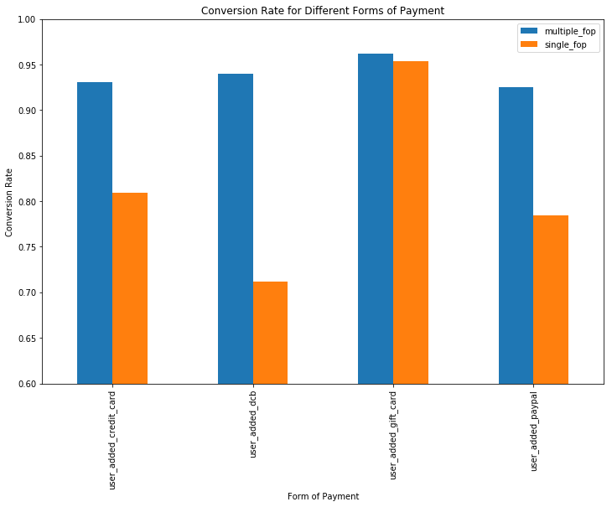
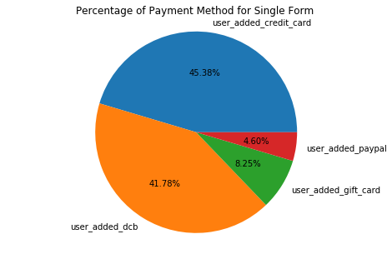
Data Visualization
-Conversion Rate
Single form of payment
Large variance
Direct Carrier Billing(42%)
Notes:
Ask more from goods: More promotion on Gift Card.
Fix things: Make ads for other payment method for dcb users.
Conversion Rate Formula

Slide 8
Experiment Design

Slide 9
A/B Test
Visit App Store
Group A
App in Cart
Click to Buy
Pay and Go
Group B
Ads for Credit Card
Notes:
We can conclude:
More than 40% users only have dcb payment, but the conversion rate is low
Gift card has the highest conversion rate
For the single payment view, Credit Card has higher conversion rate than Paypal
...
Now we have several possible strategies.
Ask more from good: Credit card discount raises from 3% to 3.5%
Fix things: Find those who only use Direct Billing Method. See where they usually go. Then make ads for credit card.
...
Assume that we choose to "Fix things". Next step is to perform A/B test. Users, who only use Direct Billing Method as the FOP, are most likely to view 'GAMES', 'MOVIES' and 'MUSIC'. Totally, 49166 users are involved, with 24695 users in case group and 24471 users in control group.

Slide 10
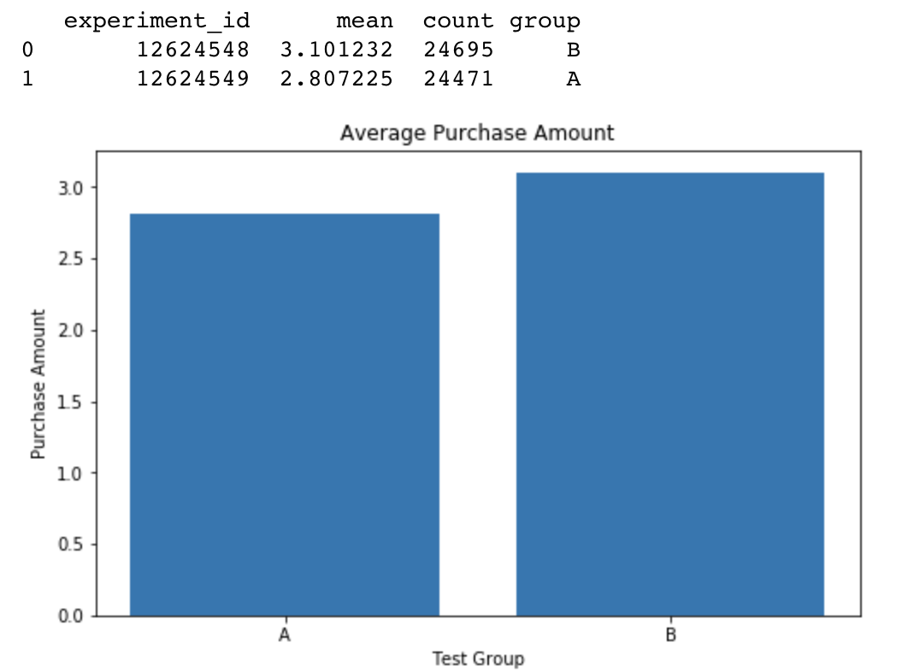
Test
Result
P-value
0.003< 0.01
Conclusion
Revenue from Group B is expected to increase by 10.7%.

Slide 11
Recommendation

Slide 12
Recommendation
We should persuade people who only use Direct Carrier Billing to use Credit Card by making ads.
Notes:
The

Slide 13
Next Step

Slide 14
What next?
Since the overall conversion rate is high for users with multiple forms of payment, we can also test if asking people to add new form of payment can lead to higher revenue.
We should also find methods to increase the conversion rate between ‘App in Cart’ and ‘Click to Buy’. For example, we send reminder to users if there is any app remaining in the cart.

Slide 15
Questions?

